Slide 1
Chapter 3 Instruction-Level Parallelism and Its Exploitation

Slide 2
Introduction
The potential overlap among instruction execution is called Instruction Level Parallelism (ILP) since instructions can be executed in parallel. There are mainly two approaches to exploit ILP.
Hardware based approach:
ex:Intel Pentium series
Software based approach:
ex:Intel Itanium

Slide 3
Instruction-Level Parallelism
When exploiting instruction-level parallelism, goal is to maximize minimize CPI
Pipeline CPI =Ideal pipeline CPI +Structural stalls +Data hazard stalls +Control stalls
By reducing each of the terms on the right hand side, it is possible to minimize the overall pipeline CPI.
Loop-Level Parallelism
-Exploit the parallelism among iterations of a loop(dynamically by compiler or by hardware)
for(i=1;i<=1000;i<=i+1)
x[i]=x[i] + y[i]
There are a number of techniques for converting loop level parallelism into instruction-level parallelism by unrolling the loop.
Exploiting loop-level parallelism is the use of vector instructions

Slide 4
Basic Blocks & ILP
A basic block is a straight-line code segment with no branches in or out of it.
Tend to be small:
4-7 instructions on average.
ILP within a basic block is limited.
Need ways to parallelize execution across multiple basic blocks!
If
Loop

Slide 5
Dependence
Determining how one instruction depends on another
determining how much parallelism exists in a program and how that parallelism can be exploited.
If two instructions are parallel, they can execute simultaneously in a pipeline of arbitrary depth without causing any stalls, assuming the pipeline has sufficient resources
If two instructions are dependent, they are not parallel
Types:
Data dependence: RAW
Name dependence: WAR, WAW
Control dependence: branch, jump, etc.

Slide 6
Data dependency
Instruction j is data dependent on instruction i if
Instruction i produces a result that may be used by instruction j
Instruction j is data dependent on instruction k and instruction k is data dependent on instruction
The second condition simply states that one instruction is
dependent on another if there exists a chain of
dependences of the first type between the two instructions
Dependent instructions cannot be executed simultaneously

Slide 7

Data Dependence
Dependencies are a property of programs
Pipeline organization determines if dependence is detected and if it causes a stall
Potential for a RAW hazard
Data dependence conveys:
Possibility of a hazard
Order in which results must be calculated
Upper bound on exploitable instruction level parallelism

Slide 8
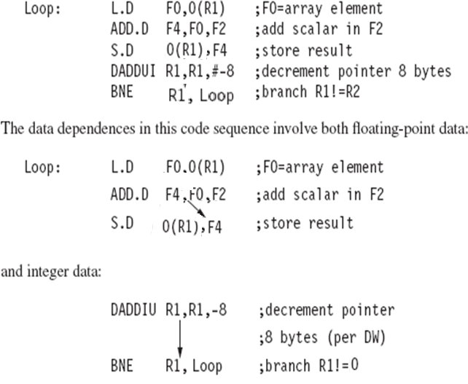


Slide 9
Name Dependence
Two instructions use the same register or memory location ,called name
. There is no flow of data between instruction associated with that name.
Not a true data dependence, but is a problem when reordering instructions
Antidependence: instruction j writes a register or memory location that instruction i reads(WAR)
Initial ordering (i before j) must be preserved
Output dependence: instruction i and instruction j write the same register or memory location(WAW)
Ordering must be preserved
To resolve, use register renaming techniques: can be done by hardware or by compiler.

Slide 10
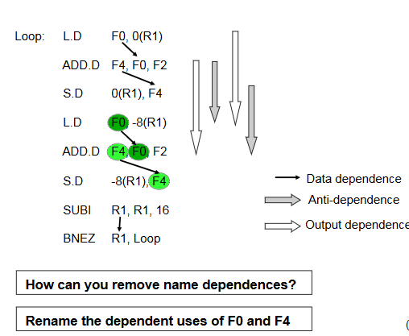

Slide 11
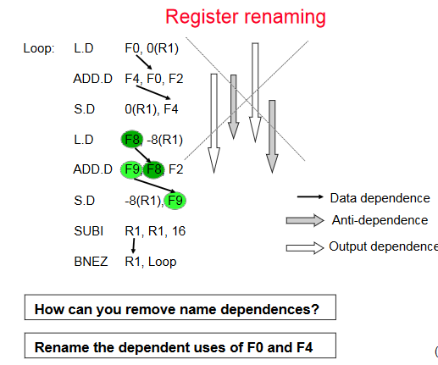

Slide 12
Control Dependence
Control Dependence
Ordering of instruction i with respect to a branch instruction
S1 is control dependent on p1, and S2 is control dependent on p2 but not on p1.
Instruction control dependent on a branch cannot be moved before the branch so that its execution is no longer controlled by the branch (e.g., cannot move s1 before if(p1) )
An instruction not control dependent on a branch cannot be moved after the branch so that its execution is controlled by the branch (e.g., cannot move p3=0 into {s2})
if (p1)
{s1};
p3=0;
if (p2)
{s2};

Slide 13
When processors preserve strict program order, they ensure that control dependences are also preserved.
Control dependence is not the critical property that must be preserved.
Two properties critical to program correctness—exception behaviour and the data flow.
-Exception behaviour means that any changes in the ordering of instruction execution must not change how exceptions are raised in the program
- The data flow is the actual flow of data values among instructions that produce results and those that consume them.

Slide 14
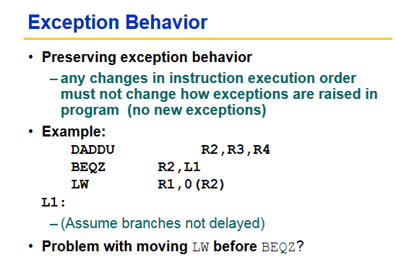

Slide 15
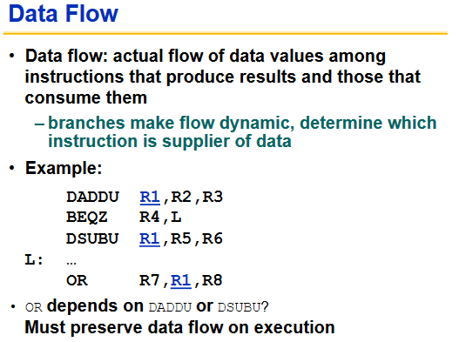

Slide 16
Compiler Techniques for Exposing ILP
To keep a pipeline full, parallelism among instructions must be exploited by ﬁnding sequences of unrelated instructions that can be overlapped in the pipeline.
To avoid a pipeline stall, a dependent instruction must be separated from the source instruction
Loop unrolling is replicating loop body multiple times, adjusting loop termination code.

Slide 17
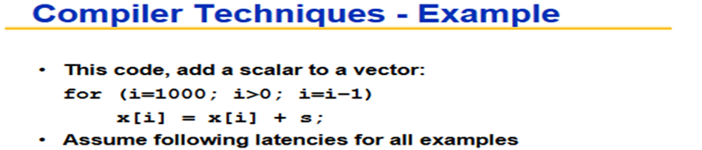
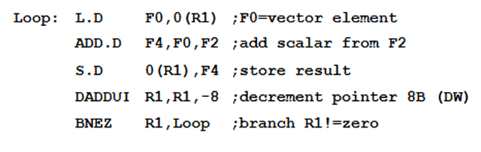

Slide 18
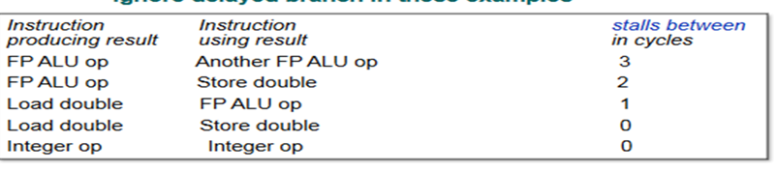
Delay(Assumption)

Slide 19


Slide 20
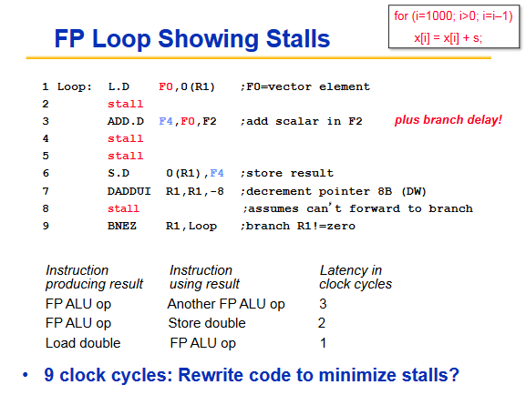
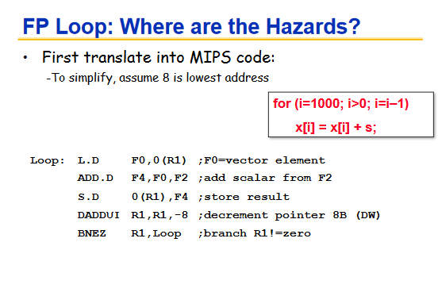

Slide 21
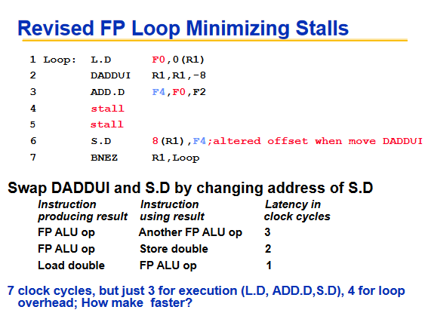

Slide 22
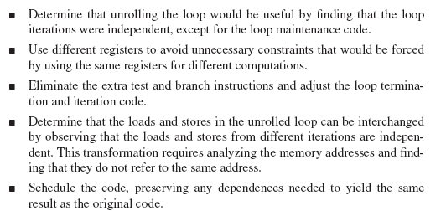
Summary of the Loop Unrolling and Scheduling

Slide 23
Reducing Branch Cost With Prediction Static Branch Prediction
To reorder code around branches, need to predict branch statically when compile
Simplest scheme is to predict a branch as taken
Average misprediction = untaken branch frequency = 34% SPEC
More accurate scheme predicts branches using profile information collected from earlier runs, and modify prediction based on last run

Slide 24
Dynamic Branch Prediction
Dynamic branch-prediction scheme is a branch-prediction buffer or branch history table.
small memory indexed by the lower portion of the address of the branch instruction.
The memory contains a bit that says whether the branch was recently taken or not.
Prediction may or may not be correct.

Slide 25
Solution 1:1-bit prediction scheme
The simple prediction scheme
It has a performance shortcoming:
Even if a branch is almost always taken, we will likely predict incorrectly twice, rather than once
when it is not taken, since the misprediction causes the prediction bit to be flipped.

Slide 26
Solution: 2-bit prediction schemes
prediction will miss only if we misprediction twice
special “cache” accessed with the instruction address during the IF pipe stage
If the instruction is decoded as a branch and if the branch is predicted as taken, fetching begins from the target as soon as the PC is known.
Otherwise, sequential fetching and executing continue.
To exploit more ILP, the accuracy of our branch prediction becomes critical.

Slide 27
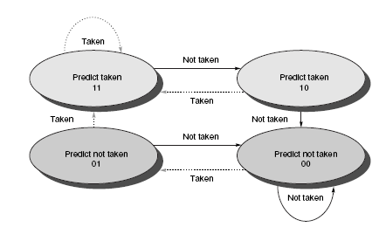

Slide 28
Correlating Branch Predictors
The 2-bit predictor schemes use only the recent behaviour of a single branch to predict the future behaviour of that branch
Prediction accuracy if we also look at the recent behaviour of other branches rather than just the branch we are trying to predict.
Branch predictors that use the behavior of other branches to make a prediction are called correlating predictors

Slide 29
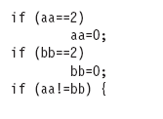
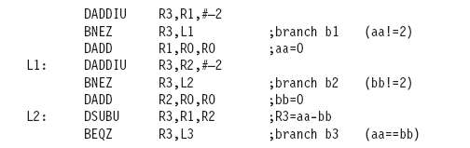
A predictor that uses only the behaviour of a single branch to predict the outcome of that branch can never capture this behaviour.

Slide 30
(1,2) predictor uses the 2-bit branch predictors in predicting a particular branch.
(m,n) predictor uses the behavior of the last m branches to choose from 2^{m} branch predictors, each of which is an n-bit predictor.
The number of bits in an (m,n) predictor =
2^{m} × n × Number of prediction entries selected by the branch address

Slide 31
How many bits are in the (0,2) branch predictor with 4K entries? How many entries are in a (2,2) predictor with the same number of bits?

Slide 32
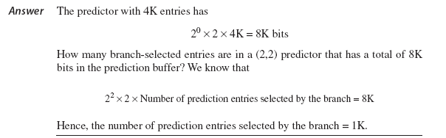

Slide 33

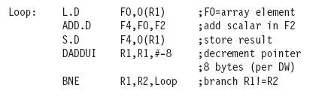

Slide 34
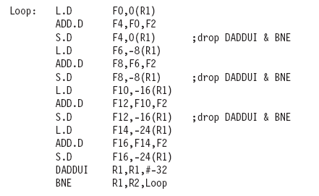

Slide 35
Overcoming Data Hazards with Dynamic Scheduling
Rearrange order of instructions to reduce stalls while maintaining data flow
Advantages:
Compiler doesn’t need to have knowledge of microarchitecture
Handles cases where dependencies are unknown at compile time
-allows the processor to tolerate unpredictable delays such as cache misses, by executing other code while waiting for the miss to resolve
- allows code that was compiled with one pipeline in mind to run efficiently on a different pipeline
Disadvantage:
Substantial increase in hardware complexity
Complicates exceptions

Slide 36
Dynamic Scheduling
In a dynamically scheduled pipeline, all instructions pass through out of order execution.
We have split the ID pipe stage of our simple five-stage pipeline into two stages:
1. Issue—Decode instructions, check for structural hazards.
2. Read operands—Wait until no data hazards, then read operands.

Slide 37
Score boarding : is a technique for allowing instructions to execute out of order when there are sufficient resources and no data dependences;
Tomasulo’s Approach
Tracks when operands are available
Introduces register renaming in hardware
Minimizes WAW and WAR hazards

Slide 38
Tomasulo’s scheme
Register renaming eliminates these hazards by renaming all destination registers
out-of-order write does not affect any instructions that depend on an earlier value of an operand
In Tomasulo’s scheme, register renaming is provided by reservation stations, which buffer the operands of instructions waiting to issue
Reservation station fetches and buffers an operand as soon as it is available, eliminating the need to get the operand from a register
More reservation stations than real registers: eliminate hazards

Slide 39
Hazard detection and execution control are distributed:
The information held in the reservation stations ,
results are passed directly to functional units from the reservation stations where they are buffered, rather than going through the registers.
Instructions are sent from the instruction unit into the instruction queue from which they are issued in FIFO order.
The reservation stations include the operation and the actual operands, as well as information used for detecting and resolving hazards.

Slide 40
All results from either the FP units or the load unit are put on the CDB, which goes to the FP register file as well as to the reservation stations and store buffers.
The FPadders implement addition and subtraction, and the FP multipliers do multiplication and division.

Slide 41
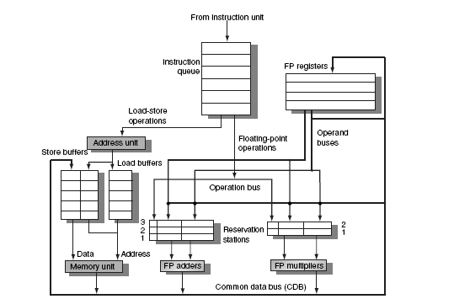

Slide 42
Tomasulo’s Algorithm
Three Steps:
Issue
Get next instruction from FIFO queue
If available RS, issue the instruction to the RS with operand values if available
Execute
. If one or more of the operands is not yet available ,monitor the
common bus while waiting for it to be computed
When all operands are ready, issue the instruction
Loads and store maintained in program order through effective address
Write result
When result is available write it to CDB from their to register and into any reservation station.

Slide 43
Op—The operation to perform on source operands S1 and S2.
Qj, Qk—The reservation stations that will produce the corresponding source operand; a value of zero indicates that the source operand is already available in Vj or Vk, or is unnecessary.
A—Used to hold information for the memory address calculation for a load or store.
Vj, Vk—The value of the source operands.
Busy—Indicates that this reservation station and its accompanying functional unit are occupied.
Qi—The number of the reservation station that contains the operation whose result should be stored into this register

Slide 44
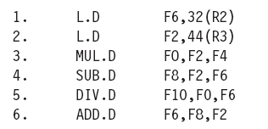
Dynamic Scheduling: Examples and the Algorithm
Q.Show what the information tables look like for the following code sequence when only the first load has completed and written its result

Slide 45
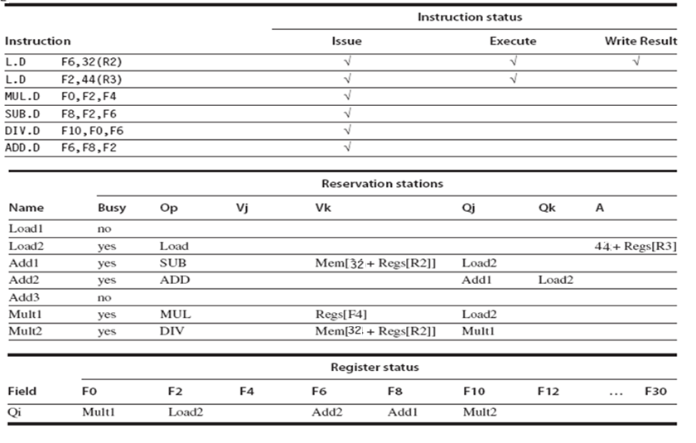

Slide 46
Hardware-Based Speculation
Extends the idea of dynamic scheduling with three key ideas:
Dynamic branch prediction to choose which instructions to execute
Speculation to allow the execution of instructions before control dependencies are resolved
Dynamic scheduling to deal with scheduling different combinations of basic blocks
What we saw earlier was within a basic block
Dynamic scheduling without speculation only partially overlaps basic blocks because it requires that a branch be resolved before actually executing any instructions
Hardware-based speculation follows the predicted flow of data values to
choose when to execute instructions.

Slide 47
Hardware-Based Speculation
Extends the idea of dynamic scheduling with three key ideas:
Dynamic branch prediction
Speculation to allow the execution of instructions before control dependencies are resolved
Dynamic scheduling to deal with scheduling different combinations of basic blocks
What we saw earlier was within a basic block
Modern processors started using speculation around the introduction of the PowerPC 603, Intel Pentium II and extend Tomasulo’s approach to support speculation

Slide 48
Speculating with Tomasulo
The key difference between Tomasulo’s algorithm and Speculation
once an instruction writes its result, any subsequently issued instructions will find the result in the register file.
With speculation, the register file is not updated until the instruction commits
Add a hardware buffer, called the reorder buffer (ROB), with registers to hold the result of an instruction between completion and commit
ROB supplies operands in the interval between
completion of instruction execution and instruction commit
allow instructions to execute out of order but to force them to commit in order

Slide 49
Speculating with Tomasulo
Separate execution from completion
Allow instructions to execute speculatively but do not let instructions update registers or memory until they are no longer speculative
Instruction Commit
After an instruction is no longer speculative it is allowed to make register and memory updates
Allow instructions to execute and complete out of order but force them to commit in order
Add a hardware buffer, called the reorder buffer (ROB), with registers to hold the result of an instruction between completion and commit
Acts as a FIFO queue in order issued

Slide 50
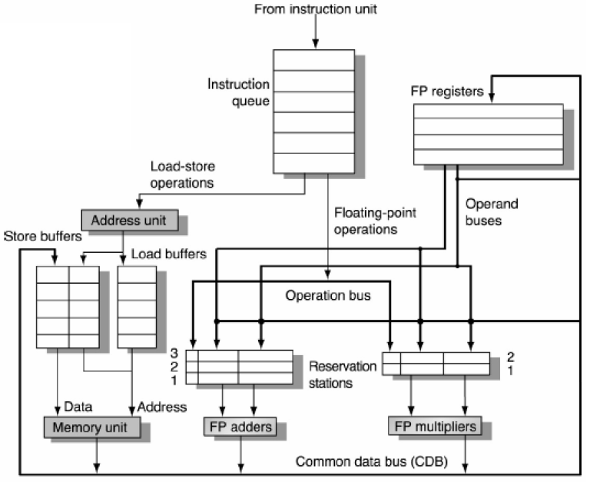
Original Tomasulo Architecture

Slide 51
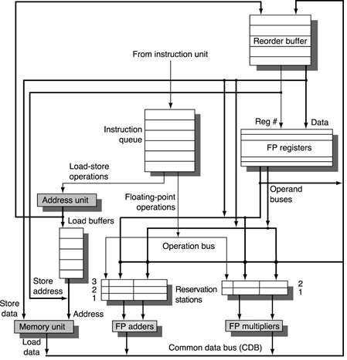
Tomasulo and Reorder Buffer
Sits between Execution and Register File
In this case integrated with Store buffer
Reservation stations use ROB slot as a tag
Instructions commit at head of ROB FIFO queue
Easy to undo speculated instructions on mispredicted branches or on exceptions

Slide 52
ROB Data Structure
Instruction Type Field
Indicates whether the instruction is a branch, store, or register operation
Destination Field
Register number for loads, ALU ops, or memory address for stores
Value Field
Holds the value of the instruction result until instruction commits
Ready Field
Indicates if instruction has completed execution and the value is ready

Slide 53
Instruction Execution
Issue: Get an instruction from the Instruction Queue
If the reservation station and the ROB has a free slot (no structural hazard), issue the instruction to the reservation station and the ROB, send operands to the reservation station if available in the register file or the ROB. The allocated ROB slot number is sent to the reservation station to use as a tag when placing data on the CDB.
Execution: Operate on operands (EX)
When both operands ready then execute; if not ready, watch CDB for result
Write result: Finish execution (WB)
Write on CDB to all awaiting units and to the ROB using the tag; mark reservation station available
Commit: Update register or memory with the ROB result
When an instruction reaches the head of the ROB and results are present, update the register with the result or store to memory and remove the instruction from the ROB
If an incorrectly predicted branch reaches the head of the ROB, flush the ROB, and restart at the correct successor of the branch
Blue text = Change from Tomasulo

Slide 54
Exploiting ILP Using Multiple Issue and Static Scheduling
CPI ≥ 1 if issue only 1 instruction every clock cycle
Multiple-issue processors come in 3 flavors:
statically-scheduled superscalar processors,
dynamically-scheduled superscalar processors, and
VLIW (very long instruction word) processors (static sched.)
The 2 types of superscalar processors issue varying numbers of instructions per clock
use in-order execution if they are statically scheduled, or
out-of-order execution if they are dynamically scheduled
VLIW processors, in contrast, issue a fixed number of instructions formatted either as one large instruction or as a fixed instruction packet with the parallelism among instructions explicitly indicated by the instruction (Intel/HP Itanium)

Slide 55
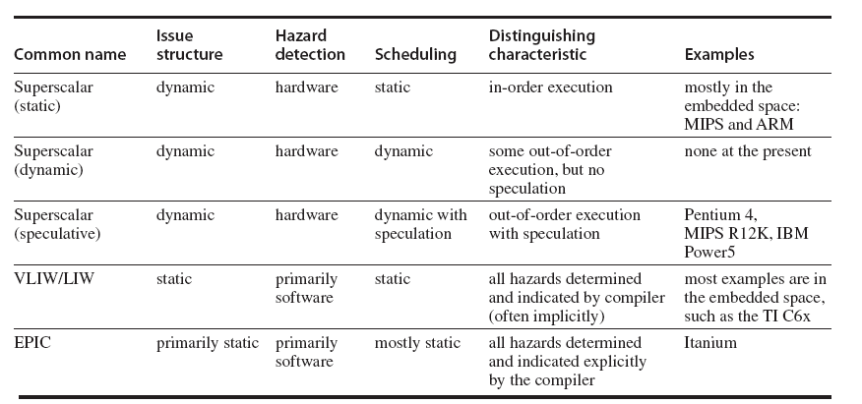

Slide 56
VLIW: Very Large Instruction Word
Packages the multiple operations into one very long instruction, or requires that the instructions in the issue packet satisfy the same constraints.
advantage of a VLIW increases as the maximum issue rate grows
To keep the functional units busy, there must be enough parallelism in a code sequence to fill the available operation slots.

Slide 57
VLIW Processors
Package multiple operations into one instruction
Example VLIW processor:
One integer instruction (or branch)
Two independent floating-point operations
Two independent memory references
Must be enough parallelism in code to fill the available slots
Multiple Issue and Static Scheduling

Slide 58
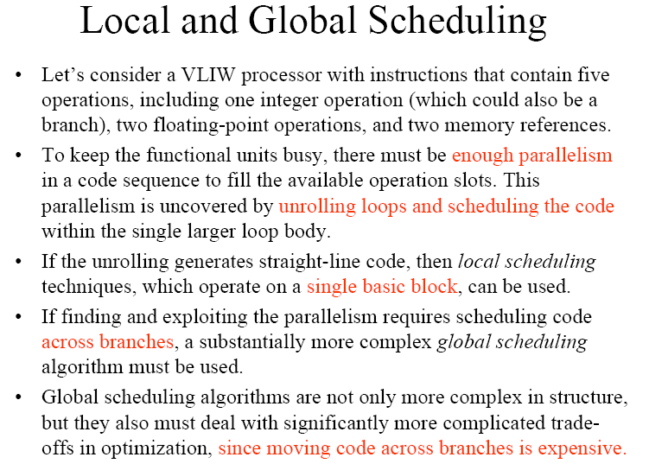

Slide 59
Problems with 1st Generation VLIW
Disadvantages:
Statically finding parallelism
Code size
No hazard detection hardware
Binary code compatibility

Slide 60
Advanced Techniques for Instruction Delivery and Speculation
Delivering 4–8 instructions every clock cycle.
advanced speculation techniques
use of register renaming
reorder buffers
the aggressiveness of speculation
value prediction
which could further enhance ILP.

Slide 61
Increasing Instruction Fetch Bandwidth
A multiple issue processor will require that the average number of instructions fetched every clock cycle be at least as large as the average throughput.

Slide 62
Branch-Target Buffer
If the instruction is a branch and we know what the next PC should be, we can have a branch penalty of zero.
A branch-prediction cache that stores the predicted address for the next instruction after a branch is called a branch-target buffer or branch-target cache
If the PC of the fetched instruction matches a PC in the prediction buffer, then the corresponding predicted PC is used as the next PC.
If a matching entry is found in the branch-target buffer, fetching begins immediately at the predicted PC.

Slide 63
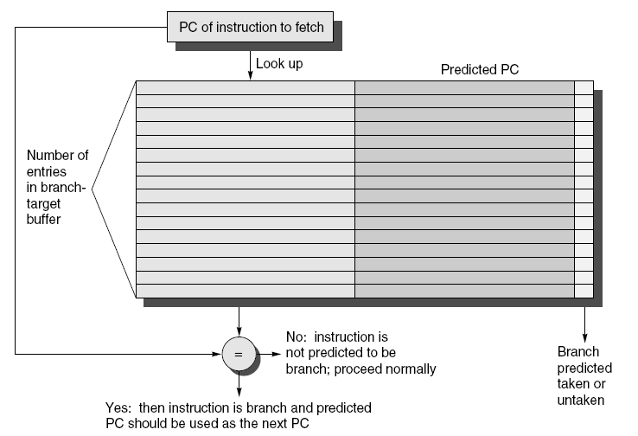
Branch-Target Buffer

Slide 64
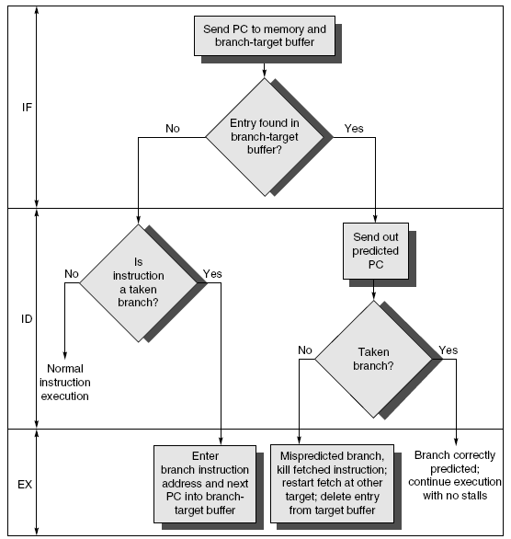

Slide 65
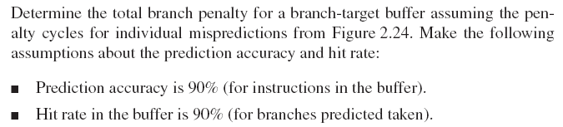
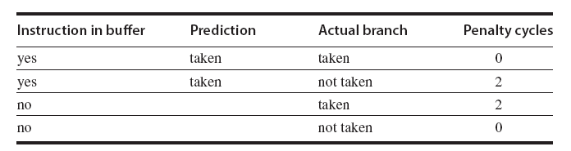

Slide 66
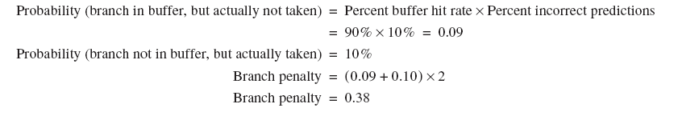

Slide 67
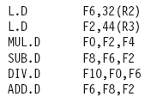
For the following instructions draw the status of reorder buffer, reservation station when MUL.D is ready to go to commit and two load instructions all ready commited.
Assume the following latencies. add is 2 clock cycles, multiply is 6 clock cycles, and divide is 12 clock cycles.

Slide 68
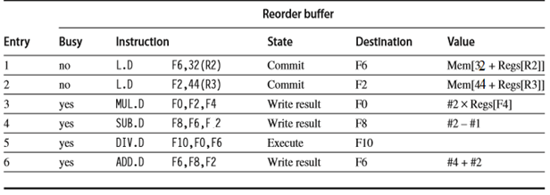

Slide 69
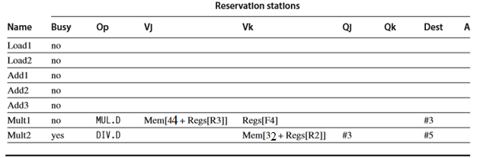

Slide 70
